Slide 1

School of Computing Science and Engineering
Course Code : BCS01T1001 Course Name: Data Analytics
UNIT IV
Introduction about Tableau, Installing Tableau Public
Name of the Faculty: Bibhas Kumar Rana Program Name: B.Tech

Slide 2

Software process and Process Models
Introduction about Tableau, Installing Tableau Public
Tableau is an amazing platform for seeing, understanding, and making key decisions based on your data.
With it, you will be able to achieve incredible data discovery, data analysis, and data storytelling.
you will be interacting with your data in a visual environment where everything that you drag and drop will be translated into the necessary queries for you and then displayed visually.
Program Name: B.Tech
2

Slide 3
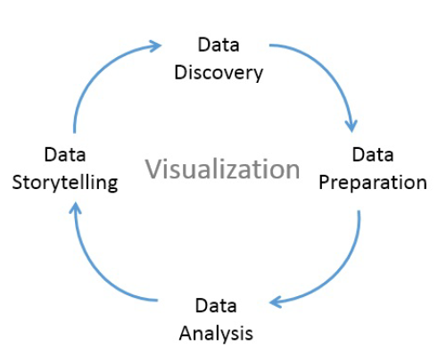
Software process and Process Models
Introduction about Tableau, Installing Tableau Public
The cycle of Analytics
The cycle of analytics is given below:
Program Name: B.Tech
3

Slide 4
Software process and Process Models
Introduction about Tableau, Installing Tableau Public
Tableau allows you to jump to any step of the cycle, move freely between steps, and iterate through the cycle very rapidly.
With Tableau, you have the ability to do the following:
Data discovery:
You can very easily explore a dataset using Tableau and begin to understand what data you have visually.
Program Name: B.Tech
4

Slide 5
Software process and Process Models
Introduction about Tableau, Installing Tableau Public
Data preparation:
Tableau allows you to connect to data from many different sources and, if necessary, create a structure that works best for your analysis.
Most of the time, this is as easy as pointing Tableau to a database or opening a file, but Tableau gives you the tools to bring together even complex and messy data from multiple sources.
Program Name: B.Tech
5

Slide 6
Software process and Process Models
Introduction about Tableau, Installing Tableau Public
Data analysis:
Tableau makes it easy to visualize the data, so you can see and understand trends, outliers, and relationships.
Tableau has an ever-growing set of analytical functions that allow you dive deep into understanding complex relationships, patterns, and correlations in the data.
Program Name: B.Tech
6

Slide 7
Software process and Process Models
Introduction about Tableau, Installing Tableau Public
Data storytelling:
Tableau allows you to build fully interactive dashboards and stories with your visualizations and insights so that you can share the data story with others.
Data visualization is the heart of Tableau.
Program Name: B.Tech
7

Slide 8
Software process and Process Models
Introduction about Tableau, Installing Tableau Public
How Does Tableau Work?
While Tableau lets you analyze databases and spreadsheets like never before, you don’t need to know anything about databases to use Tableau.
In fact, Tableau is designed to allow business people with no technical training to analyze their data efficiently.
Tableau is based on three simple concepts:
Connect
Analyze and
Share
Program Name: B.Tech
8

Slide 9
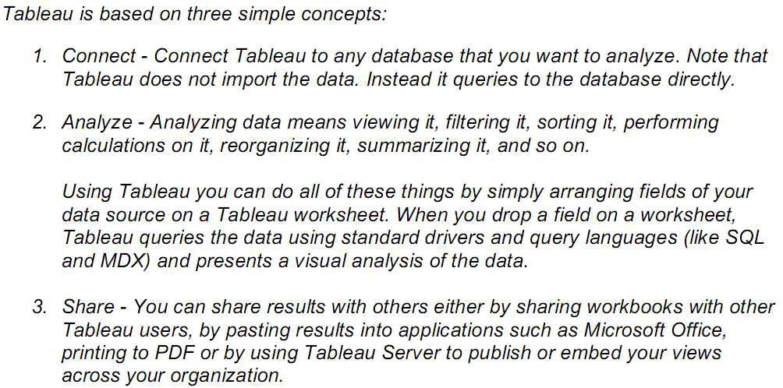
Software process and Process Models
Introduction about Tableau, Installing Tableau Public
Program Name: B.Tech
9

Slide 10
Software process and Process Models
Introduction about Tableau, Installing Tableau Public
Tableau Public
Free and Open Source
Data Source Connection:Connect to Excel and text files
Publish/Save: Can be published only in Tableau Public profile.
OS:Windows and Mac
Security:Data and visualizations are not secured as it is available in public.
Data Extract:Data cannot be obtained from different data sources as it is limited to connect only excel and text files.
Program Name: B.Tech
10

Slide 11
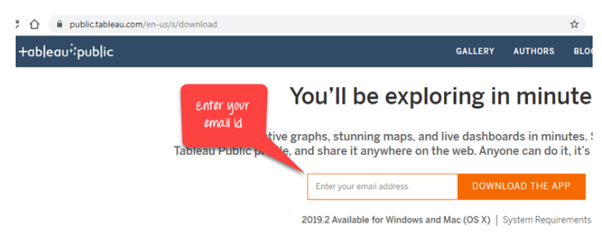
Software process and Process Models
Introduction about Tableau, Installing Tableau Public
Download and Install Tableau Public:
Step 1) Go to https://public.tableau.com/en-us/s/download on your web browser. Now you need to enter your email id and click on "DOWNLOAD THE APP" button.
Program Name: B.Tech
11

Slide 12
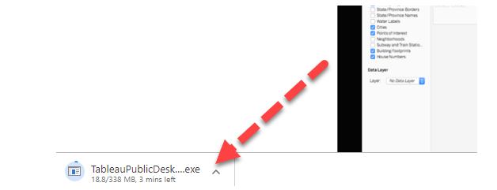
Software process and Process Models
Introduction about Tableau, Installing Tableau Public
Step 2) This will start downloading the .exe file for Windows by default, and you can see the downloading process in the bottom left corner of the website.
Program Name: B.Tech
12

Slide 13
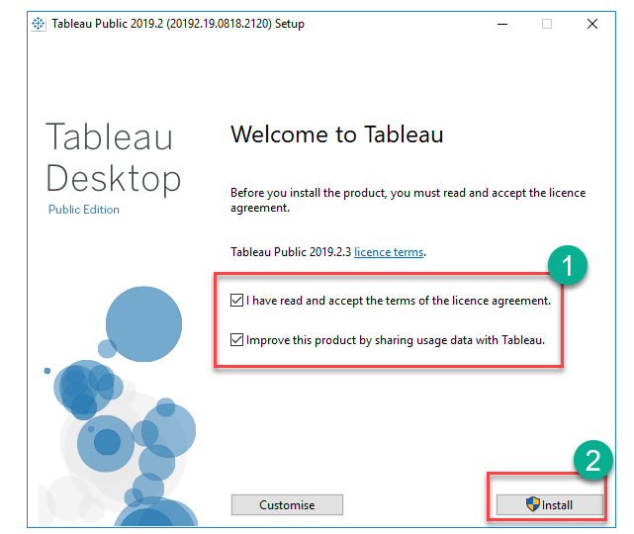
Software process and Process Models
Introduction about Tableau, Installing Tableau Public
Step 3) Open the downloaded file. Accept the terms and conditions and click on "Install" button.
Program Name: B.Tech
13

Slide 14
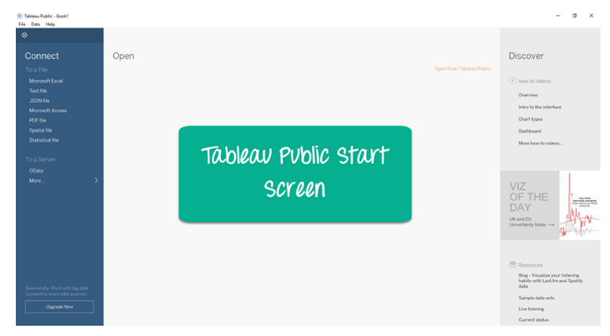
Software process and Process Models
Introduction about Tableau, Installing Tableau Public
Step 4) After installation Start Screen of Tableau is shown
Program Name: B.Tech
14

Slide 15
References
https://www.slideshare.net/girishsrivastava1/my-tableau/32
https://www.guru99.com/download-install-tableau.html
Learning Tableau 2019 Tools for Business Intelligence, data prep, and visual analytics by Joshua N. Milligan, 3rd Edition, 2019
Program Name: B.Tech

Slide 16
Software process and Process Models
Contact Information
Program Name: B.Tech
16

Slide 17


